Slide 1
SC Teacher Working
Conditions Survey

Slide 2

What is the SC Teacher Working
Conditions Survey?
The SC Teacher Working Conditions Survey explores public school and district factors related to educator support and retention. SC TEACHER is charged through Act 185 of 2022 to conduct the survey every other year.
The survey takes on average 15 minutes or less to complete.

Slide 3
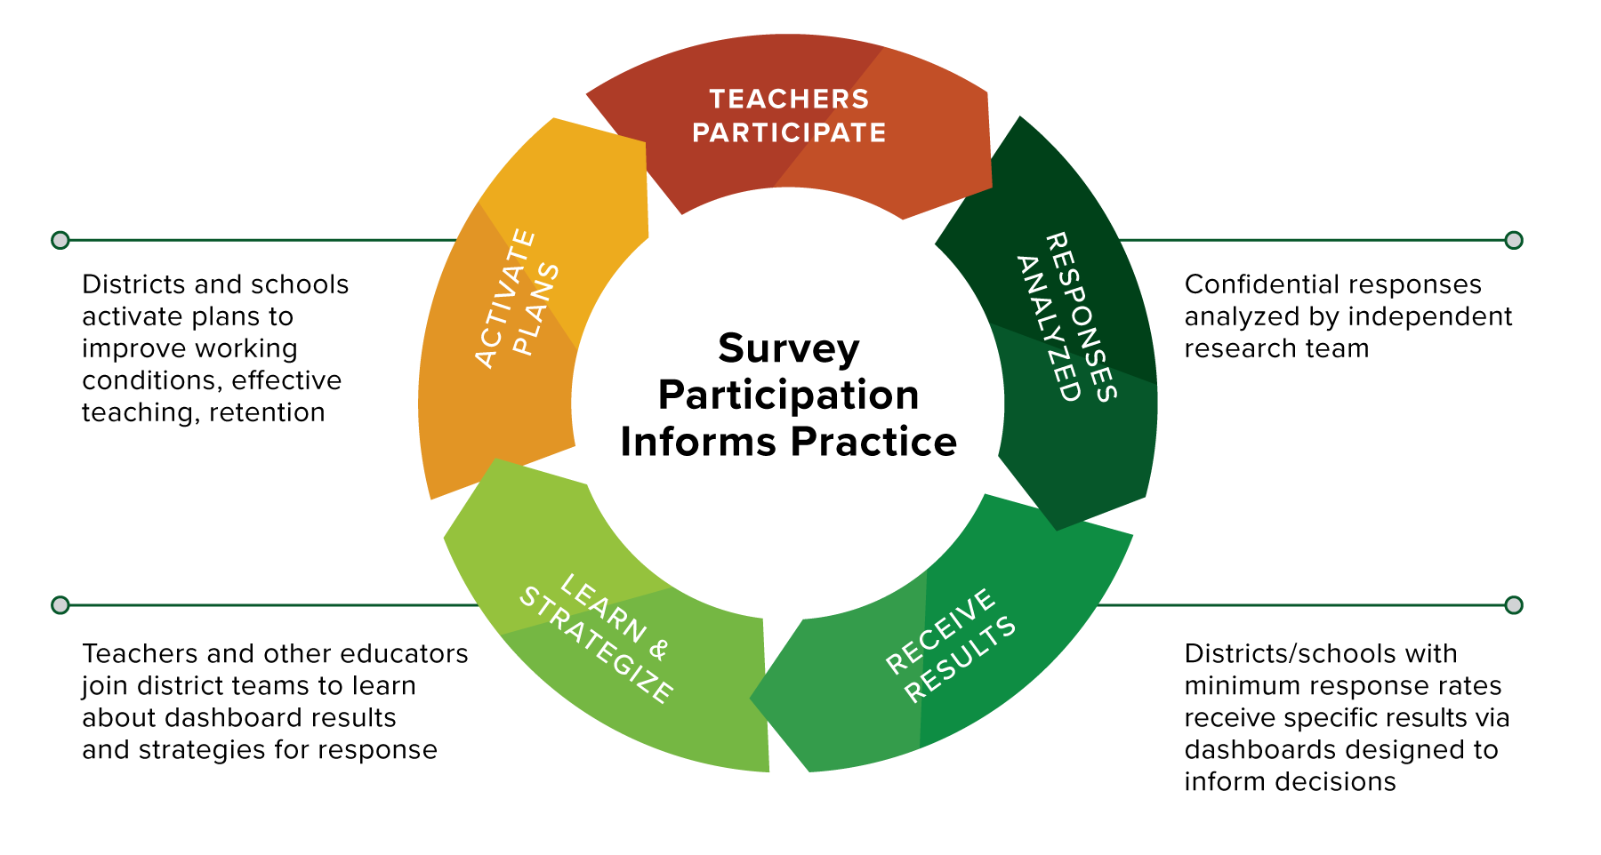

Slide 4
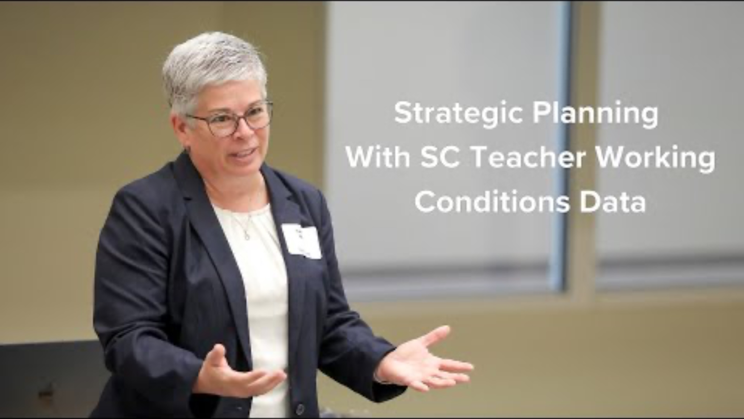
Notes:
Play this short video (1:44 minutes) to hear districts highly engaged in working with SC Teacher Working Conditions Survey data share how they’re addressing teacher working conditions with their district’s specific survey findings.
NOTE: To play the video, please click “Enable Content” in the Security Warning pop-up at the top of your PowerPoint window. Then, play the PowerPoint before clicking the video to start.

Slide 5
“The [TWC] survey results provide an opportunity to identify areas of strength and pinpoint opportunities for growth that can impact retention.”
- SC district leader

Slide 6

What happens with survey results?
At the state level…
Broad takeaways are shared in a statewide report to inform improvement of policies and practice. At the state level, data are reported only in aggregate.
Responses are confidential, meaning school- and district-level data are shared only with leadership and respondents. Teachers are not identifiable by their responses.

Slide 7
What happens with survey results?
For districts…
All participating districts receive free access to a district-specific, interactive data dashboard (that only they can access).
Districts that reach 50% participation can attend in-person workshops for unpacking data for strategic planning and continuous improvement efforts.
Districts also receive resources for support, like district- and school-level toolkits and guides for using data.

Slide 8
What happens with survey results?
For schools…
Schools that meet the participation threshold of 50% (with a minimum of 10 teachers responding) receive their results to use for internal strategic planning.
Participating teachers in these schools also receive a report of school results.
Teachers are not identifiable by their responses.

Slide 9
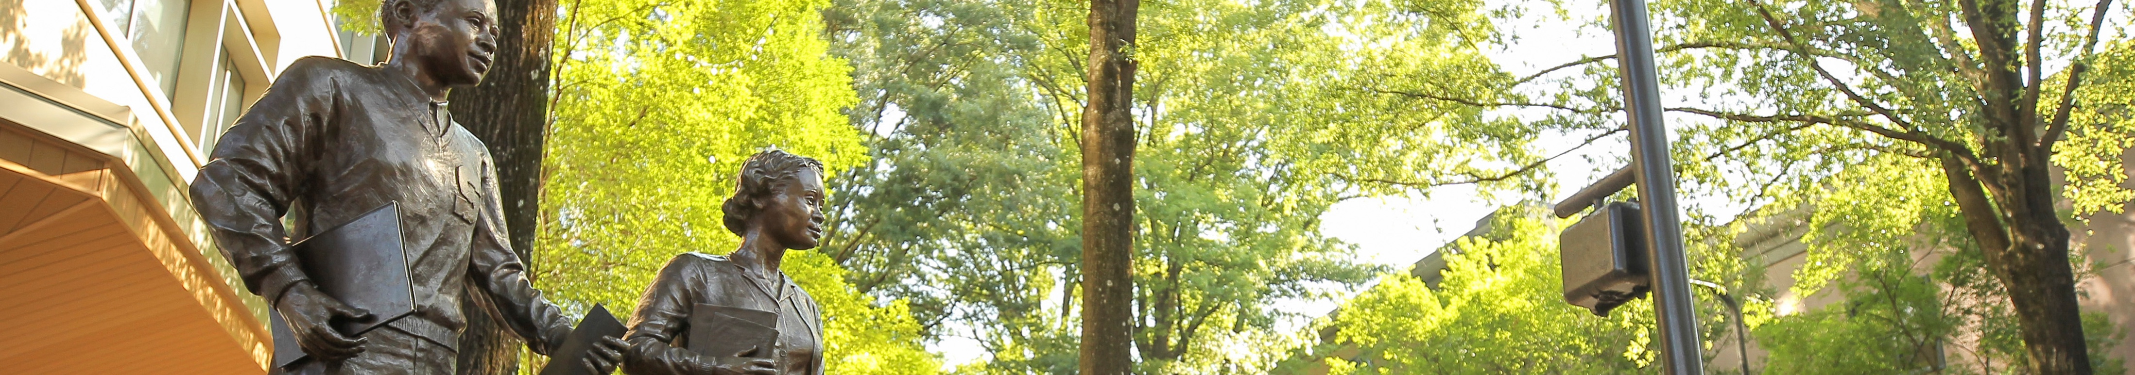
What makes this survey different from the School Climate Survey?
There are two primary differences between the surveys:
While the climate survey asks for teacher perceptions of the overall school environment, the SC Teacher Working Conditions Survey seeks to understand teachers’ individual perceptions of working conditions.
School climate information is included as part of accountability measures for schools and districts — SC Teacher Working Conditions Survey information is not.

Slide 10
When will my district have our results?
For the 2025 survey, districts will receive access to their individualized data dashboards by May 2025.
This schedule provides time for districts to consider their data in planning for the following school year, while also benefiting from free information sessions and strategic planning sessions offered by SC TEACHER.

Slide 11
When will my school have our results?
School-level reports are available for schools that meet the threshold of a 50% teacher participation rate and a minimum of 10 teachers participating.
Both principals and participating teachers will receive school-level reports in July 2025.

Slide 12
The SC Teacher Working Conditions Survey pilot administration
Captured the experiences of
ABOUT 23,500 TEACHERS
FROM 59 DISTRICTS.
A NUMBER OF DISTRICTS
are working with SC TEACHER and partners on strategic planning and improvement (at no charge to districts).

Slide 13

Districts are currently using
survey data to…
Maximize time during the school day.
Address gaps in student engagement and staff communication.
Leverage relationships between principals and teachers to strengthen conditions.

Slide 14
The 2025 SC Teacher Working Conditions Survey is gearing up
Teachers, we want to hear from you! The survey takes less than 15 minutes to complete.
  Classroom teachers will receive a link to take the survey via their district email addresses.
  Survey administration will run from Jan. 13–Feb. 14, 2025.
  Questions about the survey? Email SCTinfo@mailbox.sc.edu.

Slide 15
Teachers, your involvement makes a difference. Survey participation means more data and better insights to improve working conditions.

Slide 16

Notes:
This slide features a live animation. Please put this PowerPoint in presentation mode to see the animation in effect.

