Slide 1
SC Teacher Working
Conditions Survey

Slide 2
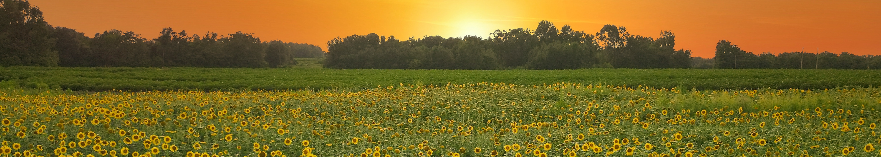
What is the SC Teacher Working
Conditions Survey?
The SC Teacher Working Conditions Survey (SCTWCS) explores public school and district factors related to teacher workplace resources and demands, job satisfaction, and retention.
SC TEACHER is charged through Act 185 of 2022 to conduct the survey every other year.
The survey takes on average 15 minutes or less to complete.

Slide 3
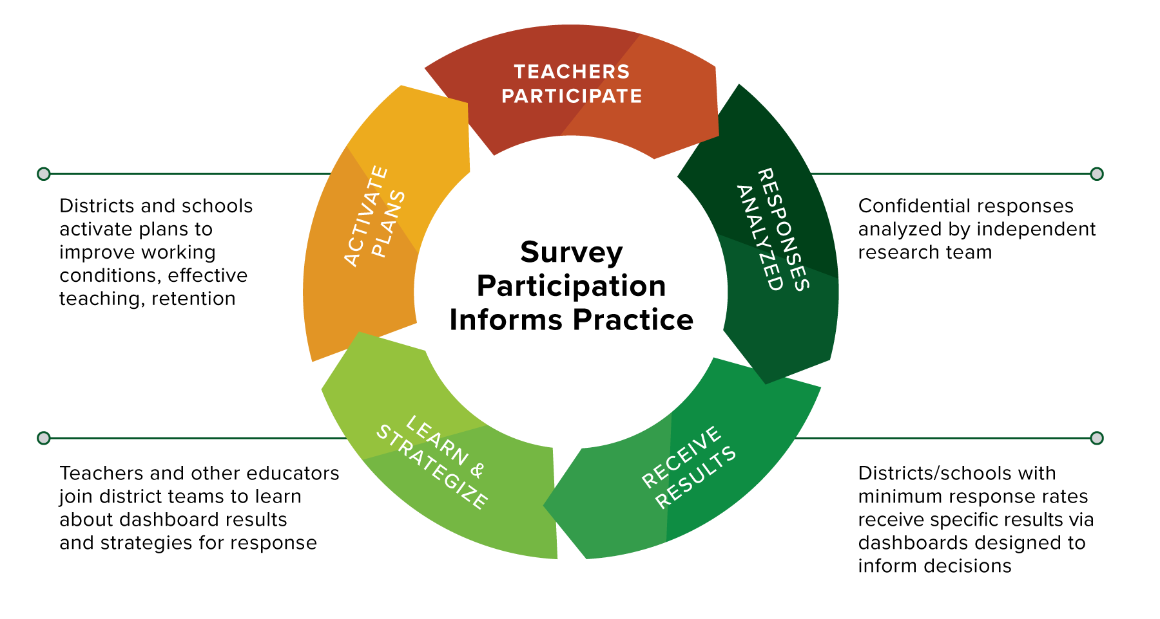
Districts act on data, informing decisions around strategic planning
Confidential responses analyzed by independent research team
District teams explore survey results with support from researchers and facilitators
Districts receive specific results via their District Landscape

Slide 4
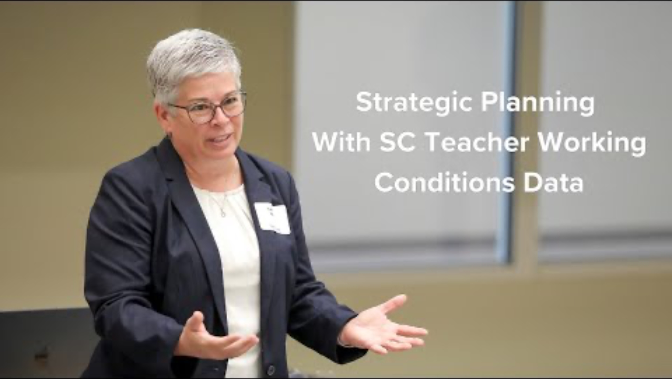
Notes:
Play this short video (1:44 minutes) to hear districts highly engaged in working with SC Teacher Working Conditions Survey data share how they’re addressing teacher working conditions with their district’s specific survey findings.
NOTE: To play the video, please click “Enable Content” in the Security Warning pop-up at the top of your PowerPoint window. Then, play the PowerPoint before clicking the video to start.

Slide 5
“Survey results provide an opportunity to identify areas of strength and pinpoint opportunities for growth that can impact retention.”
- An SC district leader

Slide 6

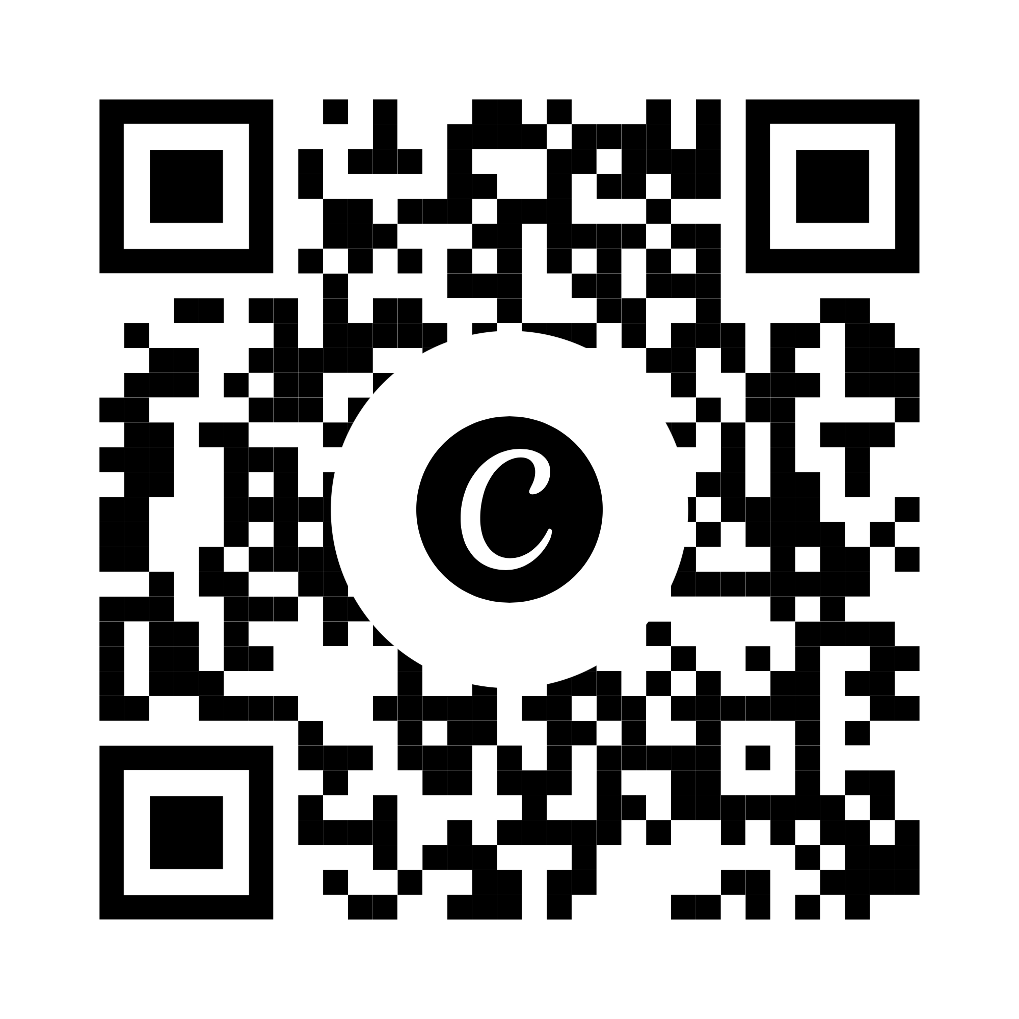

What happens with survey results?
At the state level…
Read the 2025 report + overview
Broad takeaways shared in a statewide report to inform policies and practice
School- and district-level data shared only with district leadership (meeting participation thresholds)
Teachers not identifiable by their responses

Slide 7
What happens with survey results?
For districts…
Free access to their specific results via the District Landscape (accessible only by district leadership)
Those that reach 50% participation can attend in-person workshops—unpacking data for strategic planning and continuous improvement efforts
Districts also receive resources for support, like district- and school-level toolkits, crosswalks, and guides for using data

Slide 8
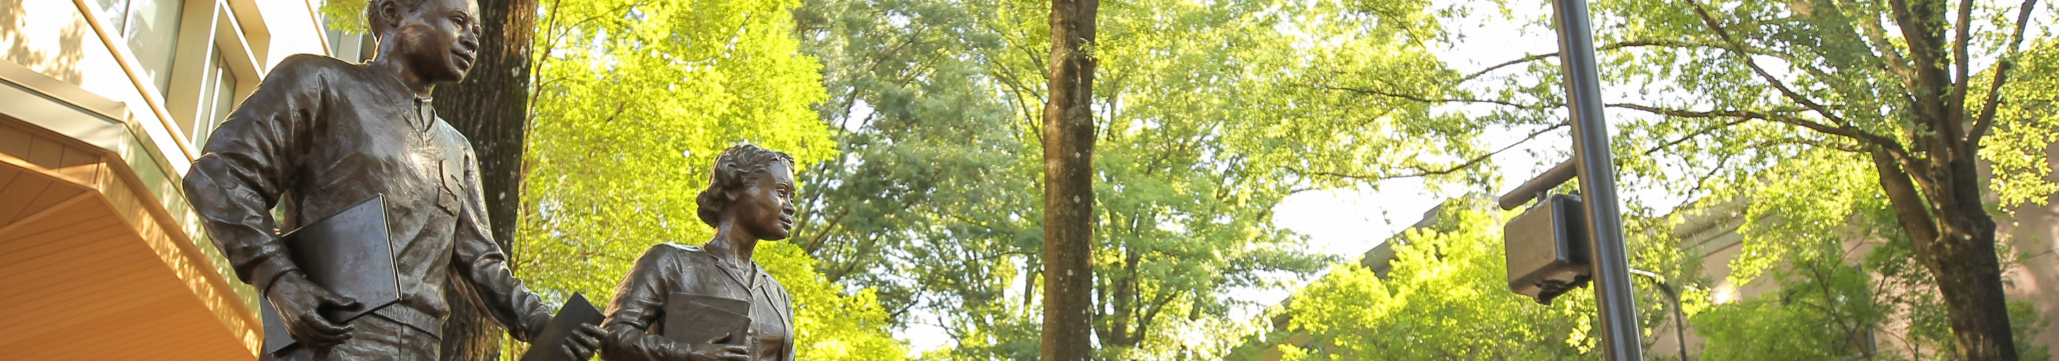
What makes this survey different from the School Climate Survey?
There are two primary differences between the surveys:
The climate survey asks for teacher perceptions of the overall school environment. The SC Teacher Working Conditions Survey seeks to understand teachers’ individual perceptions of working conditions.
School climate information is included as part of accountability measures for schools and districts — SC Teacher Working Conditions Survey information is not.

Slide 9
When will my district have our results?
For the 2027 survey, results will be available via the District Landscape by June 2027.
This schedule provides time for districts to consider their data in planning for the following school year, while also benefiting from free strategic planning sessions offered by SC TEACHER.

Slide 10
Unpack results at the
2027 SC TEACHER Insights Symposium
Save the date! The 2027 SC TEACHER Insights Symposium will take place June 8–9, 2027.
At the symposium, SC TEACHER researchers and facilitators will walk district teams through accessing and applying results.

Slide 11
The 2025 SC Teacher Working Conditions Survey
Captured the experiences of
ABOUT 25,000 TEACHERS
FROM 54 TRADITIONAL DISTRICTS
A number of districts are working with SC TEACHER researchers and facilitators on strategic planning and improvement
(at no charge to districts).

Slide 12

Districts can use survey data to inform…
Cognia accreditation
Funding + resource allocation
Instructional practices
School + district leadership development
Strategic planning
Professional development

Slide 13
Participate to layer data
Districts that previously participated in the SC Teacher Working Conditions Survey can track trends and shifts with continued participation + longitudinal data.

Slide 14
Participate to layer data
Districts that participated in the SC Administrator Working Conditions Survey or SC Teacher Exit Survey can analyze data across survey results for a clearer picture of district and school environments.

Slide 15
The 2027 SC Teacher Working Conditions Survey is gearing up
When the survey opens on January 11, encourage teachers in your district to participate for more data + better insights

Slide 16
Teachers, we want to hear from you!
The survey takes less than 15 minutes to complete.
  Each classroom teacher will receive an individual link to take the survey via their district email address.
  The survey administration will run from Jan. 11–Feb. 12, 2027.
  Questions about the survey?
  Email SCTresults@mailbox.sc.edu.

Slide 17
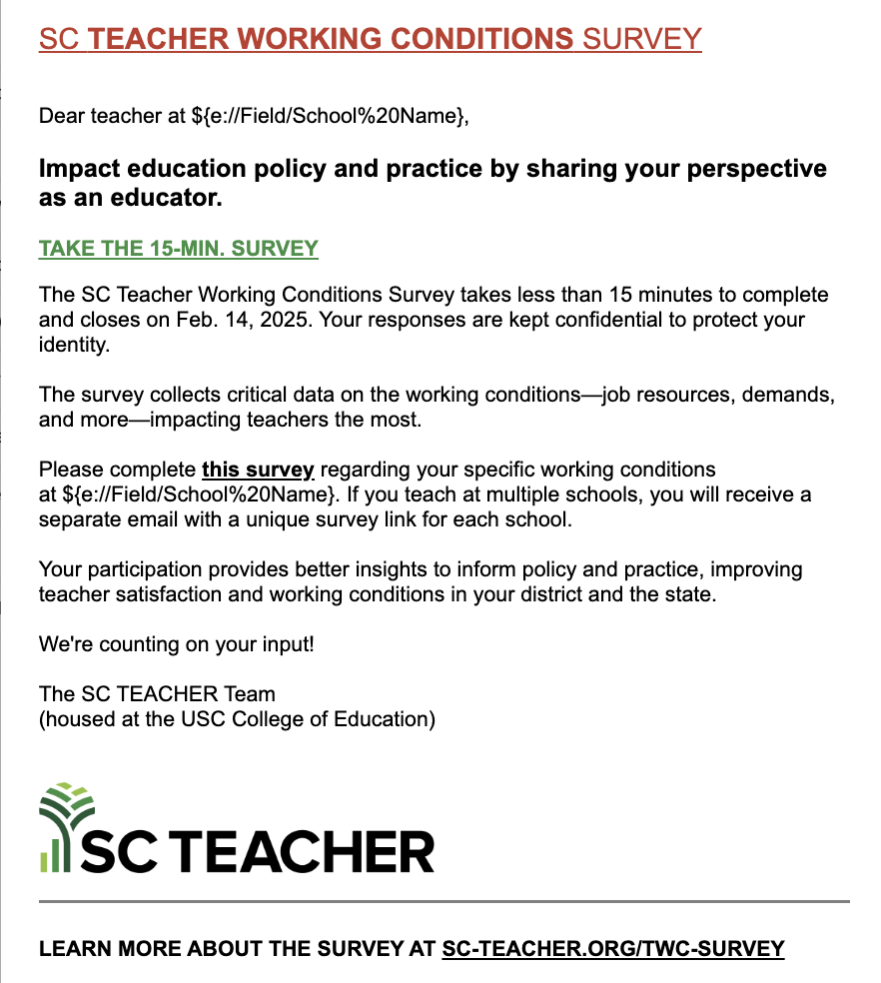
Look for this email in your inbox
All classroom teachers will receive a separate email to take the survey.
If you work in multiple schools, you will receive a separate email for each school.
Feb. 12, 2027

Slide 18
Teachers, your involvement makes a difference. Survey participation means more data and better insights to improve working conditions.

Slide 19

Notes:
This slide features a live animation. Please put this PowerPoint in presentation mode to see the animation in effect.

