Slide 1
SC Teacher Working Conditions Survey

Slide 2
What is the SC Teacher Working Conditions Survey?
The SC Teacher Working Conditions Survey explores public school and district factors related to educator support and retention. SC TEACHER is charged through Act 185 to conduct the survey on a biannual basis.
The survey takes on average less than 15 minutes to complete.

Slide 3
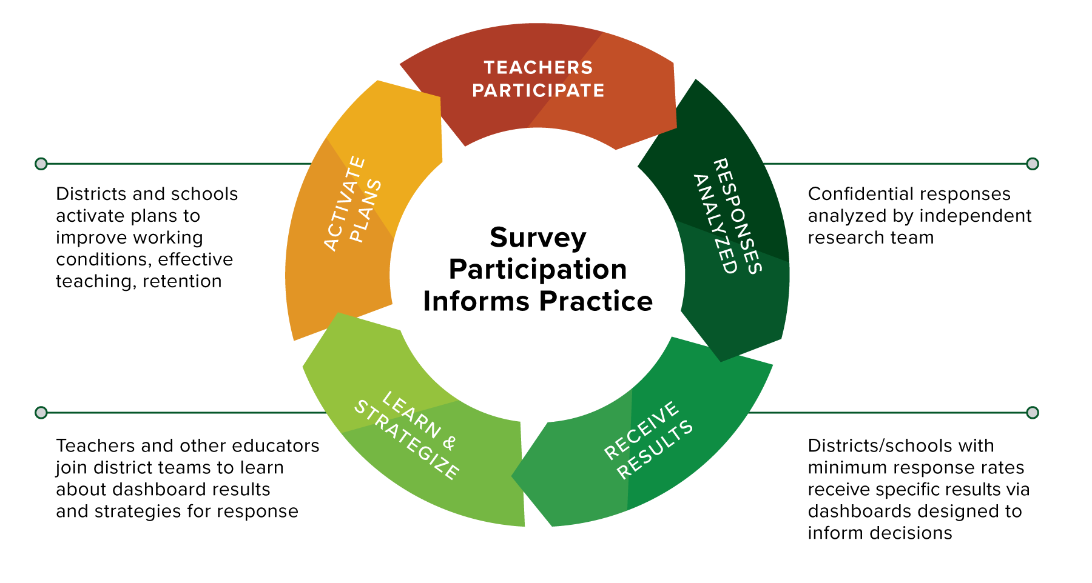

Slide 4
“The [TWC] survey results provide an opportunity to identify areas of strength and pinpoint opportunities for growth that can impact retention.” - SC district leader

Slide 5
Improvement Focus
What happens with survey results?
Broad takeaways are shared in a statewide report to inform improvement of policies and practice. Responses are confidential, meaning school- and district-level data is shared only with leadership and respondents. Teachers are not identifiable by their responses.

Slide 6
Improvement Focus
What happens with survey results?
Schools that meet the participation threshold of 50% (with a minimum of 10 teachers responding) receive their results to use for internal strategic planning.
All participating districts receive free access to resources to support them through the improvement planning process delivered as data and district- and school-level toolkits.

Slide 7
What makes this survey different from the School Climate Survey?
There are two big differences between the surveys:
While the climate survey asks for teacher perceptions of the overall school environment, the SC Teacher Working Conditions Survey seeks to understand teachers’ individual perceptions of working conditions.
School climate information is included as part of accountability measures for schools and districts — SC Teacher Working Conditions Survey information is not.

Slide 8
When will my district have our results?
Districts and schools meeting the participation threshold (a 50% response rate with a minimum of 10 teachers responding) will receive reports by June 2024.
This schedule provides time for districts to consider their data in planning for the following school year.

Slide 9
The 2023 SC Teacher Working Conditions Survey Administration
The 2023 survey captured the experiences of
MORE THAN 17,000 TEACHERS FROM 44 DISTRICTS.
MORE THAN 10 DISTRICTS
are working with SC TEACHER partners CarolinaCrED and Mira Education on strategic planning and improvement (at no charge to districts)!

Slide 10
Survey data informed priorities
of practice for districts
Maximizing time during the school day;
Addressing gaps in student engagement and staff communication;
Leveraging relationships between principals and teachers to strengthen conditions; and
Exploring micro-credentials as a tool for identifying educator expertise and incentivizing teacher participation in improvement efforts

Slide 11
The 2024 SC Teacher Working Conditions Survey is open now!
Teachers, we want to hear from you! The survey takes less than 15 minutes to complete.
Survey administration runs from Jan. 29–Feb. 16, 2024.
Questions about the survey? Email SCTinfo@mailbox.sc.edu.

Slide 12
Teachers, your involvement makes a difference. Survey participation means more data and better insights to improve working conditions.

Slide 13
Notes:
This slide features a live animation. Please put this PowerPoint in presentation mode to see the animation in effect.

